Slide 1
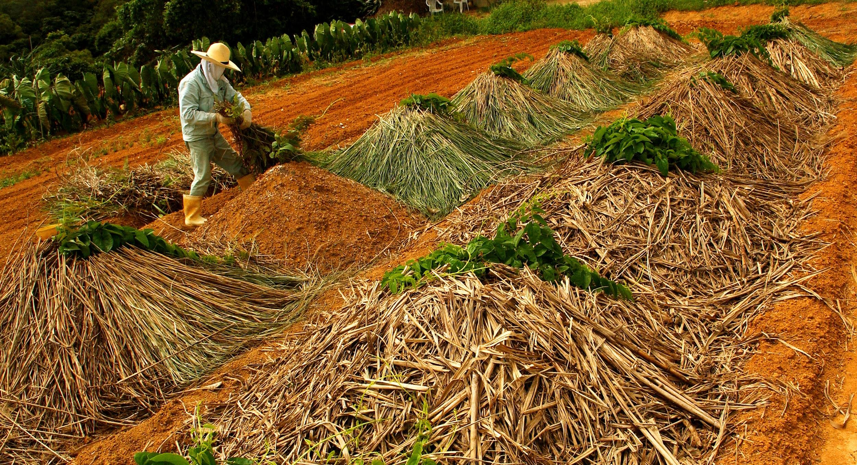
FarmHUb
SheHack’20 A-05

Slide 2
Introduction
I have designed my project "FarmHub", which help farmer to forecast about the demand using visualisation dashboard and also provide some functionality which help farmers as well as markets in farm product management/business. To do this, I have followed the following steps:
o Use code that is written in Node.js (Node Red), with the server-side using the Express framework and the client using ReactJS.
o Use the pre-built IBM Watson Functionalities.
o Access the Watson Discovery Service through the Discovery API.
o Use IBM cloud DB2 services to store the Database and to generate Query.
o Host the app on IBM Cloud.

Slide 3


Problem statement
I analyze the following functionality required along with the existing system:
Online platform which provide farmer to put their crop detail to be sold and help farmers to find suitable markets & markets to find farm area from where they can satisfy their requirement.

Slide 4
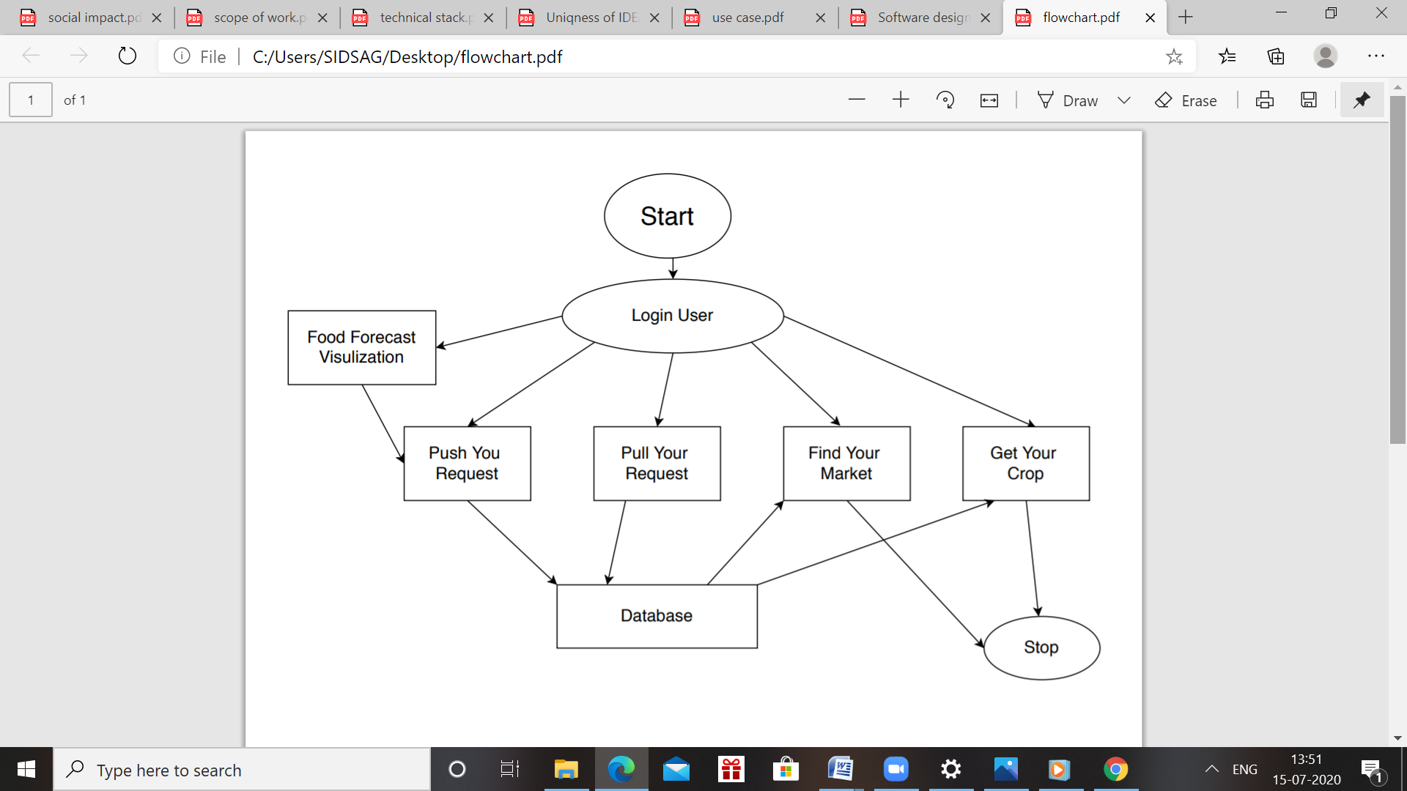
Flow Chart:

Slide 5
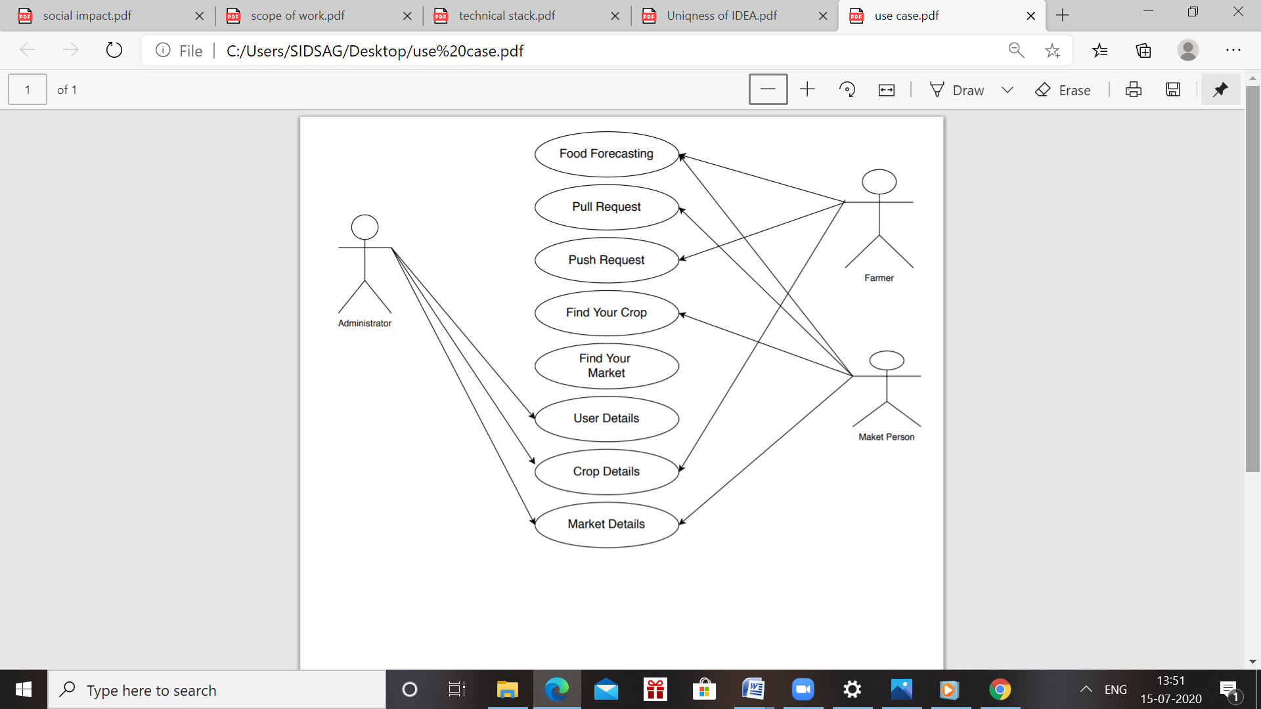
USE CASE:

Slide 6
Technology Used
● IBM Cloud.
● Node Red.
● IBM DB2 application.
● Integration of Database to Node-Red flow
● Software designing(Use cases/DFD etc.)
● GitHub.

Slide 7

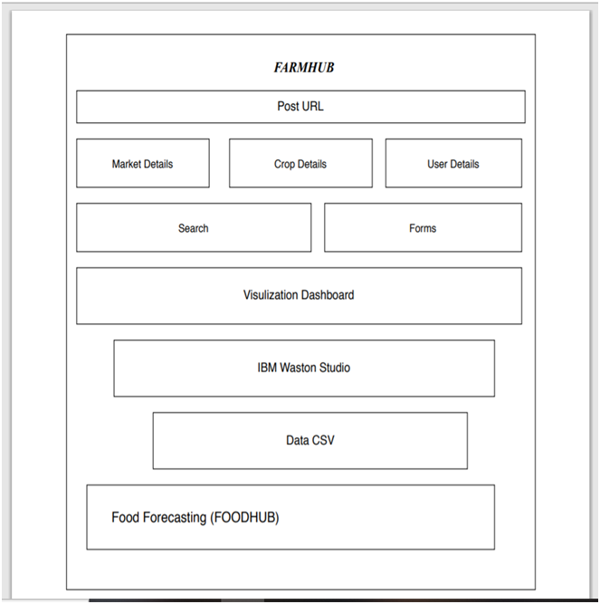
Software Design

Slide 8
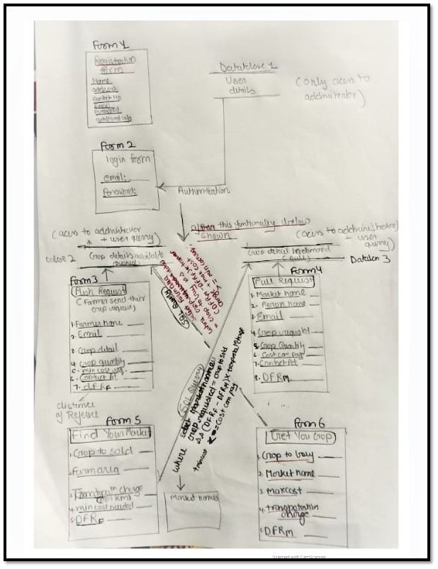
DFD

Slide 9
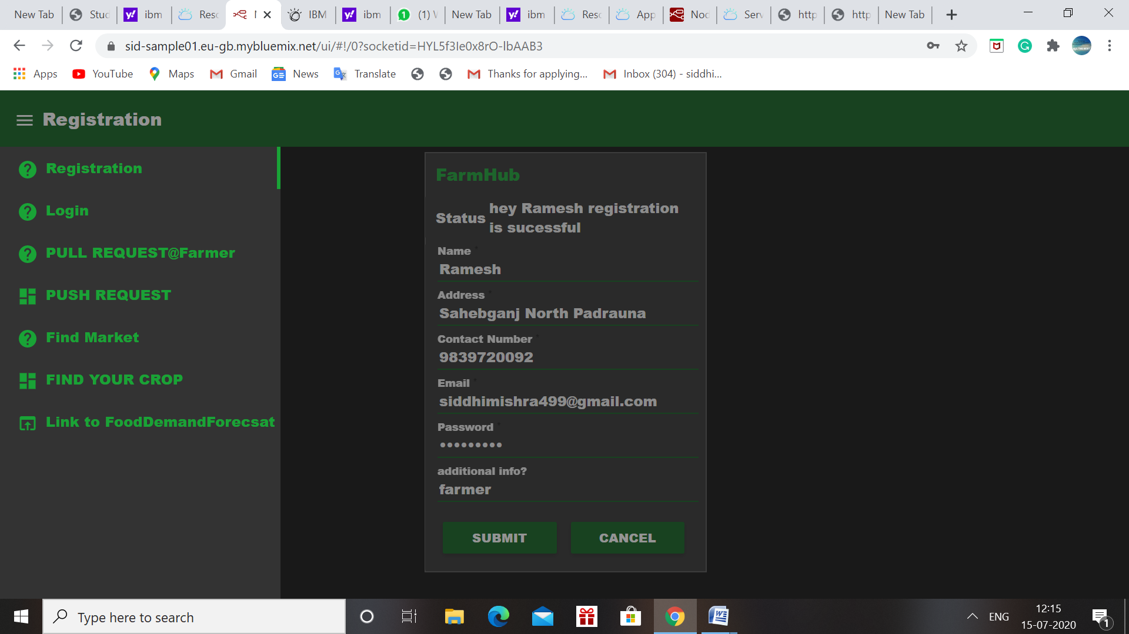
Result

Slide 10
Thanks!!

Slide 11
Advantage
FarmHub application includes following advantages:
● Easy to access the food forecast demand to predict demand helpful for market to push their request earlier.
● Less time and without going market, we can find the best suitable market and price.
.Helpful to markets, taking consideration of current situation

Slide 12
Application
"during lockdown how all the vegetables and other farms product are ruin due to lack of direct connectivity between the channels as markets are half-closed & lack of proper management .in some parts of the country some crop product like green vegetables/fruits etc are dumped as the production of that year are more than expected so the supply of that is not done in the proper manner. I got the news that many industries/cities not getting raw farm products in a proper way & as we should have to live with this scenario for unpredicted time so such activities may demotivate farmer for further cultivation investments. if we develop this technology it can be good equipment to handle the current situation for authorities and definitely is a good initiative. So, in short, we can nullify the middleman cost of farm products which is actual loss of farmers and units of demand.

Slide 13
Future Scope
· Develop a helping dashboard using IBM Chabot which can guide user about functionality and can resolve some common issues.
· Use SQL for further retrieval of data which might helpful to farmers.
1st stage |  |  |  | 2nd Stage
· Provide data security mechanism by which we can avoid misuses of data we provide to user.
· Use IBM NLP application to give feature of different language option in application.

Slide 14


